Slide 1


Fundamentals of RM
RM System and Process
Leadership in RM
Incident Investigation
RM Tools & Challenges
RM in Industry
People & Org.
Application and Perspectives
On Becoming a
Leader in Risk Management
ENGG404 - Lecture
Chapter 3.1 The Risk Management Program
Chapter 3.2 The Risk Management Work Process
Chapter 3.3 The Risk Management System
and Elements (Part 1)

Slide 2
Learning Outcomes:
Explain how a risk management program is structured.
Apply each of the steps in a risk management work process.
Explain the risk management system elements.
Differentiate between risk management system elements.
Explain the components of a risk management program.
Chapters 3.1, 3.2, and 3.3
2
Notes:
2

Slide 3
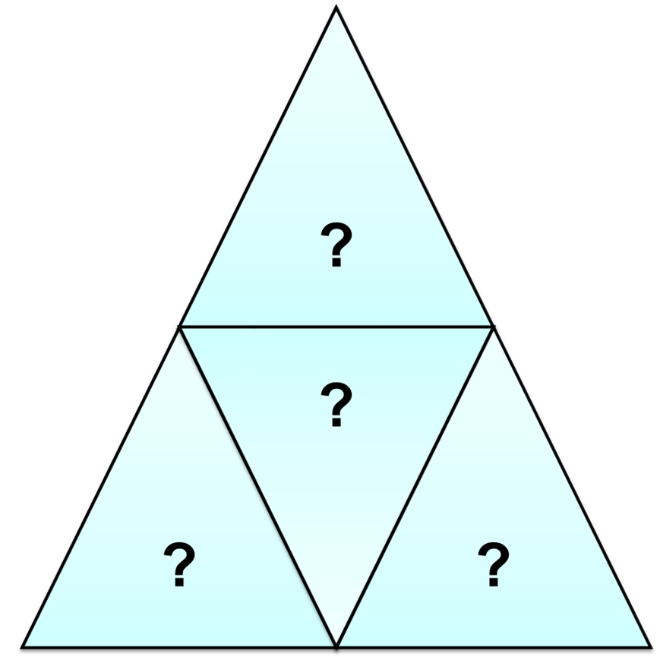
ALE #1: A Model of The Risk Management Program:
Please confer and respond on MM – Poll:
A Risk Management (RM) Program
consists of these major components:
RM System, Risk Matrix,
Risk Criteria Tables, and
Management Directions
RM System, RM Work Process,
Administrative Controls and
Work Practices, and
Engineering Controls
Hazards, Consequences,
Likelihoods, and Risk Levels
RM System, RM Work Process,
and Control Measures
Chapter 3.1 The Risk Management Program
3
Notes:
3
Think of it as an integrated set of triangles – the three components form the Risk Management Program.

Slide 4
A Model of The Risk Management Program:
Overarching program to:
Assess and reduce risk
Manage residual risk
Consists of 3 components:
RM Work Process
RM System
Control Measures
Risk Management Work Process
Control Measures
Risk Management Program
Risk Management System
Chapter 3.1 The Risk Management Program
4
Notes:
4
Simple overview here to then start introducing the RM work process

Slide 5
A Model of The Risk Management Program:
Risk Management Work Process
Let’s examine each of the
three integrated components of
The RM Program:
Control Measures
Risk Management Program
Risk Management System
Chapter 3.1 The Risk Management Program
5
Notes:
5
Think of it as an integrated set of triangles – the three components form the Risk Management Program.

Slide 6
The Risk Management Work Process:
Risk Management Work Process
Control Measures
Risk Management Program
Risk Management System
Chapter 3.2: The Risk Management Work Process
6
Notes:
6
Think of it as an integrated set of triangles – the three components form the Risk Management Program.

Slide 7
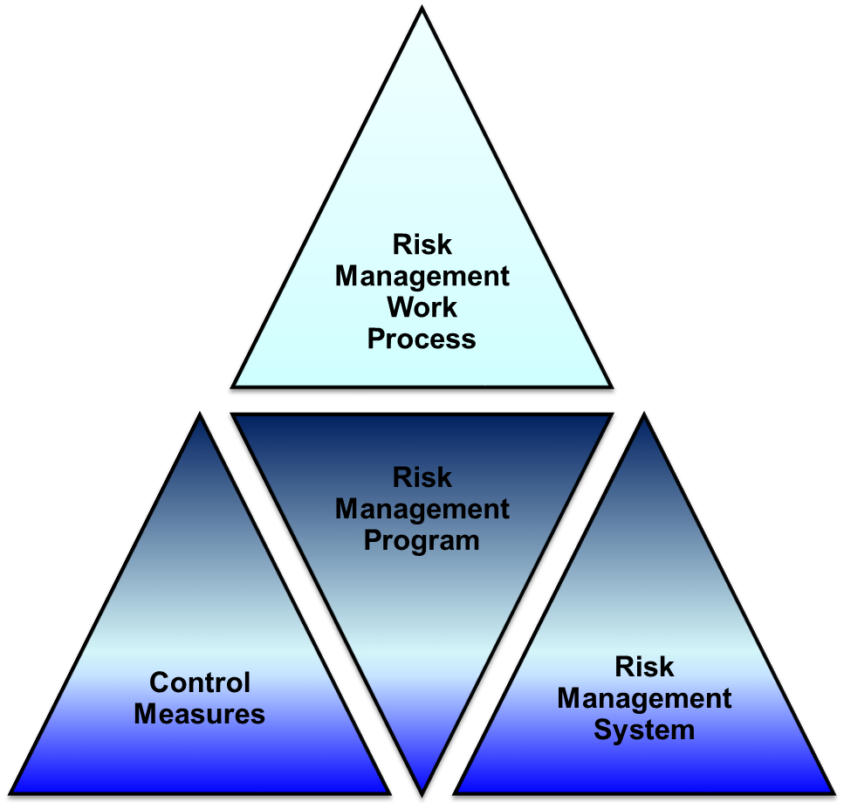
Chapter 3.2: The Risk Management Work Process:
What is a Risk Management Work Process?
One part of an overall risk management program
First analyzes risk to PEAP
What are the chances of it happening? Likelihood
How bad could it be? Consequence
Then systematically assesses that risk against what is acceptable:
To reduce risk to PEAP
Utilizing tools such as:
Risk Matrices
Risk Criteria Tables
Management Directions
Chapter 3.2: The Risk Management Work Process
7
Notes:
7
Combination of consequence and probability
Be able to draw a risk management process (for exam – know the steps)
What is the range of possible incidents that can happen?
Lots of uncertainty in undertaking activities
Resolve that uncertainty by using the same set of criteria to compare the risks (defn later on in slides)
Each step is described in the courseware
Adapted from the APEGA guidelines – explain what APEGA is

Slide 8
Flowchart of The Risk Management Work Process:
Nine (9) sequential and integrated steps!
New or existing projects
Step 3: Likelihood
and Consequence
Step 4: The risk matrix
Step 5: Ongoing process
Step 6:
Risk Management Direction
Steps 7, 8, 9:
Manage the Risks!
Be able to explain and apply this work process!
Chapter 3.2: The Risk Management Work Process
8
Notes:
8

Slide 9
Function of The Risk Management Work Process:
The function or purpose of RM WP:
Identify, Assess, & Reduce Risk
Chapter 3.2: The Risk Management Work Process
9
Notes:
9
They work together…

Slide 10
The Risk Management System and Elements
Risk Management Work Process
Control Measures
Risk Management Program
Risk Management System
Chapter 3.3: The Risk Management System and Elements
10
Notes:
10
Think of it as an integrated set of triangles – the three components form the Risk Management Program.

Slide 11
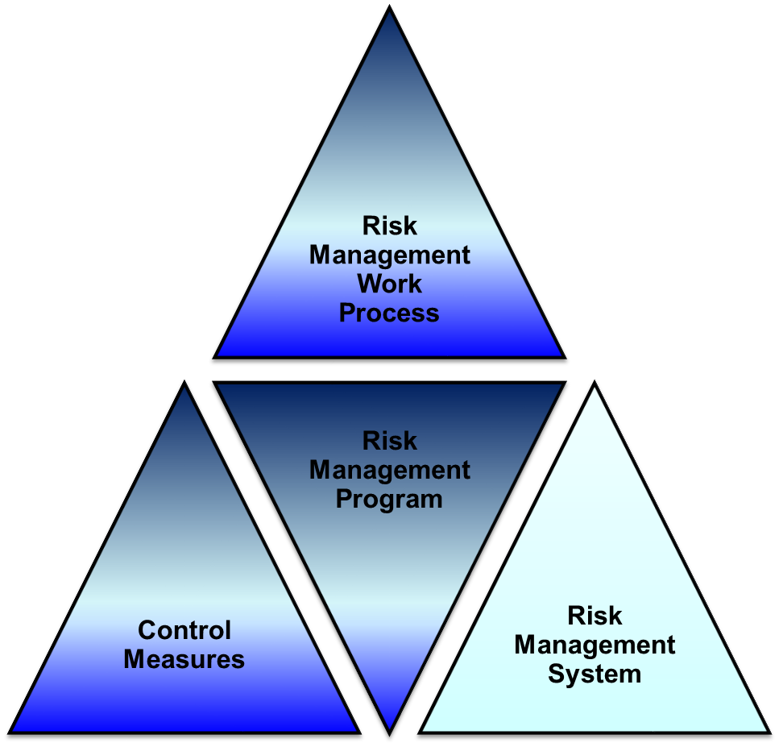
Function of The Risk Management System & Its Elements:
The function of the RMS & E:
Control & Manage
Residual Risk
Risk Management System (APEGA Model):
1) Management Leadership, Commitment and Accountability.
2) Risk Assessment and Management of Risks.
3) Community Awareness and Emergency Preparedness.
4) Management of Change.
5) Incident Reporting, Investigation, Analysis and Actions.
6) Program Evaluation and Continuous Improvement.
7) Design, Construction and Start-up.
8) Operations and Maintenance.
9) Employee Competency and Training.
10) Contractor Competency and Integration.
11) Operations and Facilities Information and Documentation.
Chapter 3.3: The Risk Management System and Elements
11
Notes:
11
They work together…

Slide 12
The Risk Management System:
RMS is a Framework:
A risk management system is a framework for leadership to control the residual risks of their organization’s activities
In general:
  defines how an organization is managed on a daily basis,
  documents the policies, work processes, and procedures by which and through which people execute their tasks and fulfill their duties,
  complies with requirements or regulations stipulated by governments, industry associations, or the organization’s corporate policies, and
  is Pro-Active!!!
Chapter 3.3: The Risk Management System and Elements
12
Notes:
12
Mgmt system – describes how an organization does work (university calendar for us, ensures the university complies with academic requirements, etc)

Slide 13
The Risk Management System – The APEGA Model:
Risk Management System (APEGA Model):
Management Leadership, Commitment and Accountability.
Risk Assessment and Management of Risks.
Community Awareness and Emergency Preparedness.
Management of Change.
Incident Reporting, Investigation, Analysis and Actions.
Program Evaluation and Continuous Improvement.
Design, Construction and Start-up.
Operations and Maintenance.
Employee Competency and Training.
Contractor Competency and Integration.
Operations and Facilities Information and Documentation.
Be able to explain and apply each of these elements!
Chapter 3.3: The Risk Management System and Elements
13
Notes:
13

Slide 14
Purpose of the Risk Management System Elements:
For Each Risk Management System Element:
All potential PEAP loss exposures are identified
What is the likelihood and consequence?
The risks in each exposure are evaluated
Risk management work process to determine residual risks
Control measures are developed
Reduce risks to an acceptable level and control residual risks
Progress monitored & responded to on an ongoing basis
  Correct deviations
Leadership drives the process and is seen to do so by all employees
Management is responsible!!!
Chapter 3.3: The Risk Management System and Elements
14
Notes:
14
This is the overall RM system – it includes the RM work process to reduce risk and then the system used to manage the residual risk

Slide 15
ALE #2: Risk Management System Elements (RME’s)
Please confer:
Which of the eleven risk management system elements do you think is the most important one? MM - Vote
Risk Management System (APEGA Model):
Management Leadership, Commitment and Accountability.
Risk Assessment and Management of Risks.
Community Awareness and Emergency Preparedness.
Management of Change.
Incident Reporting, Investigation, Analysis and Actions.
Program Evaluation and Continuous Improvement.
Design, Construction and Start-up.
Operations and Maintenance.
Employee Competency and Training.
Contractor Competency and Integration.
Operations and Facilities Information and Documentation.
Chapter 3.3: The Risk Management System and Elements
15
Notes:
15

Slide 16
Risk Management System Elements: An Exercise
The most important element …
Management Leadership, Commitment, and Accountability.
If weaknesses here, the system will fail or mediocre results at best
Management actions must be consistent between their words and actions - walk the talk
Management sets the culture and tone of the organization
Long term and pro-active commitment
EXAMPLE: Management focusing on profit, rather than on getting the job done safely
Chapter 3.3: The Risk Management System and Elements
16
Notes:
16
Most important one!!!
Focus on this in chapter 9
What gets measured gets managed

Slide 17
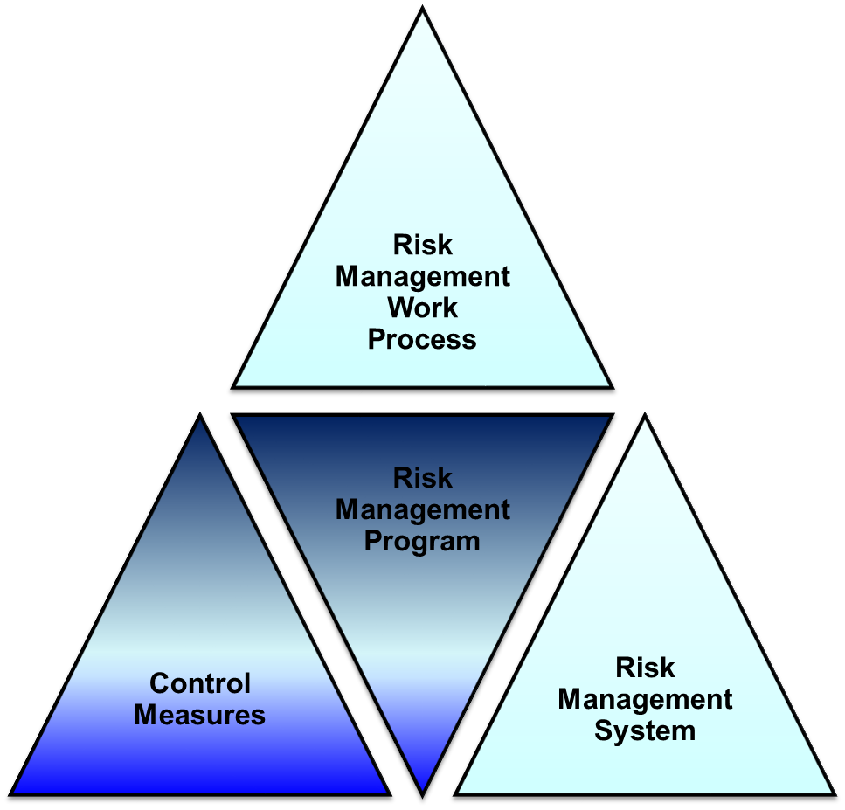
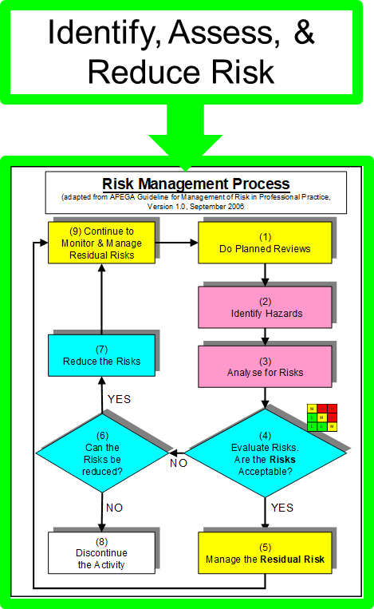
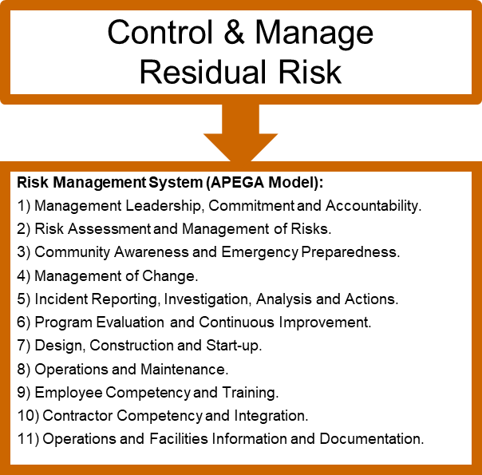
Chapter 3.1-3.2-3.3: RM Program, Work Process, System & Elements
Chapter 3.1-3.2-3.3: RM Program, Work Process, System & Elements
17
Notes:
17
Think of it as an integrated set of triangles – the three components form the Risk Management Program.

Slide 18
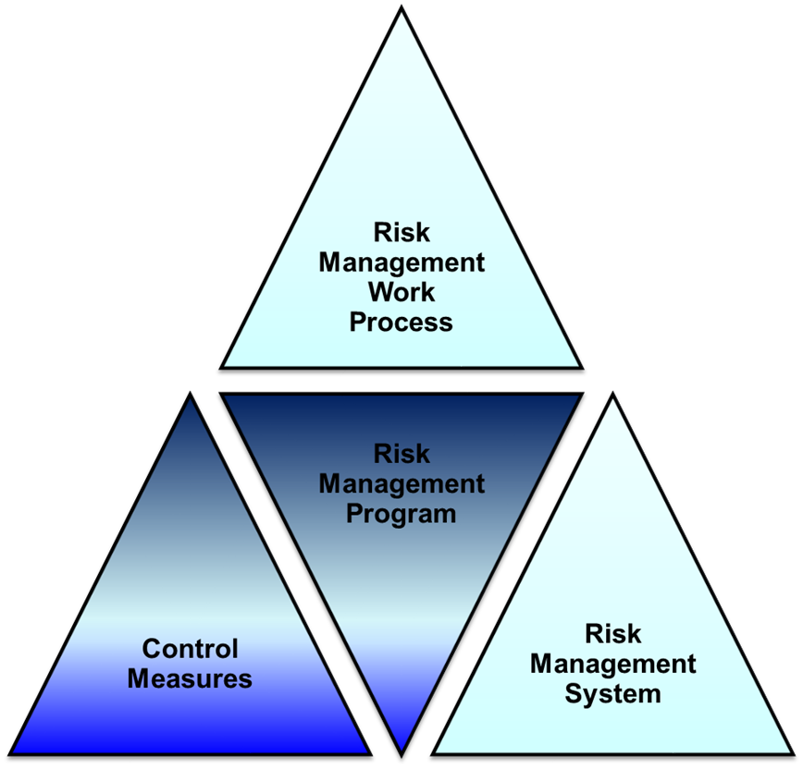
The RM System vs. RM Work Process
Differences between RM WP & RMS:
The RM Work Process directs managers
to identify risks, determine acceptability,
define and implement control measures
to reduce the risk to an acceptable level.
But the RM Work Process does not
explain how to effectively manage
and control residual risks.
The RM System using its Elements explains
how to manage and control the residual risks
of different activities within the organization.
Note: We present one model of a risk management work process, system, and program. There are many different variations that are equally valid and widely practiced in industry, governments, and agencies.
Chapter 3.1-3.2-3.3: RM Program, Work Process, System & Elements
18
Notes:
18
Compare the process with the system
RM system describes how you go through/direct the risk management process

Slide 19
Control Measures
Risk Management Work Process
Control Measures encompass
two types:
Engineering Controls
Administrative Controls
Control Measures
Risk Management Program
Risk Management System
Chapter 3.2: The Risk Management Work Process
19
Notes:
19
Think of it as an integrated set of triangles – the three components form the Risk Management Program.

Slide 20
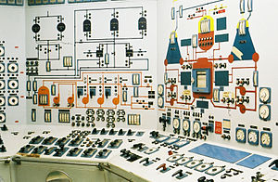
Definition: Engineering Controls
Engineering Controls:
An engineered system with specific design intent to control / mitigate a hazard and manage a risk to an acceptable level.
Chapter 3.1-3.2-3.3: RM Program, Work Process, System & Elements
20
Notes:
20
Engineering Controls: an engineered system with specific design intent to control / mitigate a hazard and manage a risk to an acceptable level.
Process equipment and process hardware (e.g. pressure vessels and pressure relief valves; automated process control systems, their sensors, and their control devices; fire suppression systems, etc.) and process software (logic that automatically activates control devices) that are put in place to prevent an incident from happening or to mitigate the incident to a safe level should it happen.

Slide 21



Definition: Administrative Controls
Administrative Controls:
A documented plan for the safe execution of work: policies, procedures, SOPs, JSAs, best practices, and check-lists.
Work Practices:
Work practices: the result of executing an administrative control
i.e. the actual execution of or “doing” the work. (Not to be confused with administrative controls that are entitled “Work Practice”)
Chapter 3.1-3.2-3.3: RM Program, Work Process, System & Elements
21
Notes:
21
Administrative Control: This specifies a safe plan for the safe execution of work. In the form of policies, procedures, and best practices.
An administrative control specifies a safe plan for the safe execution of work. It may be in the form of policies, procedures, and the best practices.
Policies and procedures are well-defined, and establish actions to safely and efficiently execute work.
Best practices are based on the skills and knowledge of trained and competent workers in their field of expertise.
Administrative Controls are put in place to prevent an incident from happening, or to mitigate the incident to a safe level should it happen. Some examples of administrative controls are: operating procedures, maintenance procedures, training requirements, procedures that control life-critical jobs (e.g. work permits, confined space entry, work at elevation, work in atmospheres immediately dangerous to life or health), and emergency response plans and tactics. These, in part, can effectively implement the intent of the risk management system.
Work practices are the result of implementing an administrative control i.e. the actual execution of or “doing” the work.

Slide 22
The Hierarchy of Administrative Controls:
Administrative Controls are documents (policies, standards, procedures, etc.) that describe the most efficient and effective way to “execute work” at an acceptable level of risk. Not all documents are created equal!
Life Critical Rules / Life Saving Rules
  Permit to Work, Hot Work, Isolation and Lock-out, Confined Space Entry, H2S
Critical Procedures
  Refinery - Fluid Catalytic Cracking Unit Cold Start-up Procedure
Reference Procedures, Checklists
  Installation Manual, Operating Manual, Maintenance and Repair Manual
  Checklists for these and above
Qualification Training
General Rules and Practices
General Training
Chapter 3.1-3.2-3.3: RM Program, Work Process, System & Elements
22
Notes:
22

Slide 23
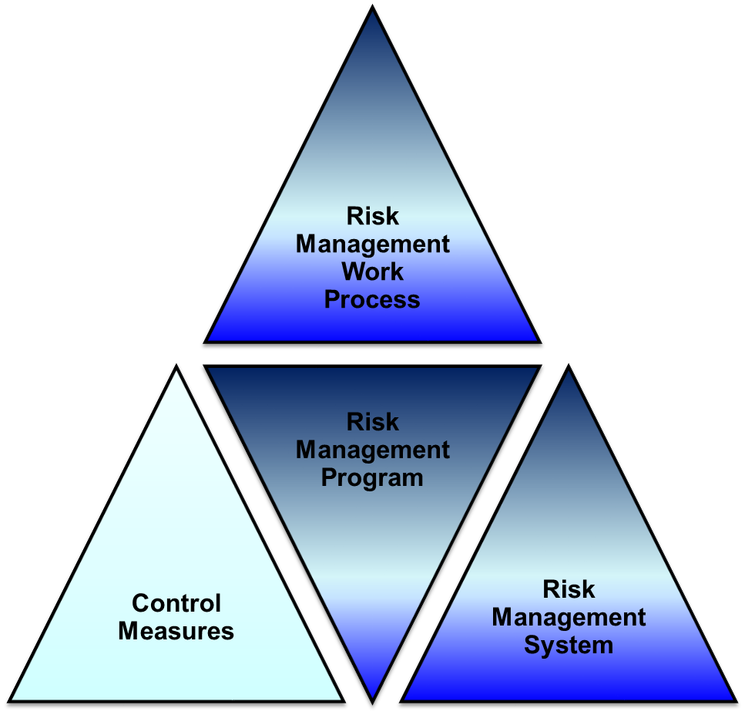
Difference: Engineering Controls and Administrative Controls
Engineering
Administrative
Chapter 3.1-3.2-3.3: RM Program, Work Process, System & Elements
23
Notes:
23
Think of it as an integrated set of triangles – the three components form the Risk Management Program.

Slide 24
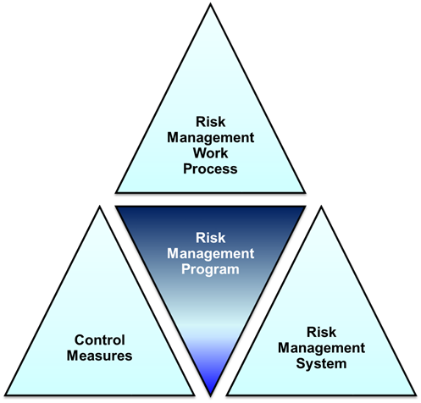
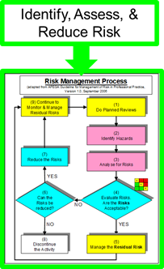
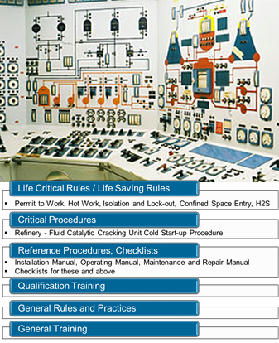
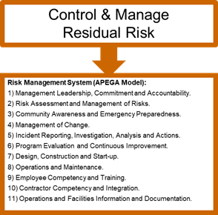
ALE #3: Match the Components
Please confer and match the components (MM-Poll):
(A) (B) (C)
(3)
(1)
(2)
Chapter 3.3: The Risk Management System and Elements
24
Notes:
24

Slide 25
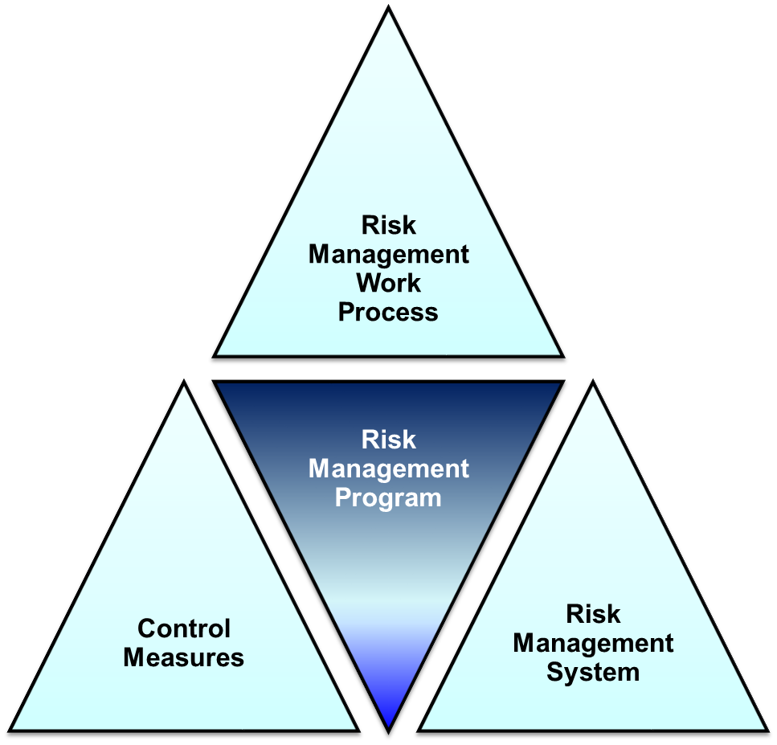
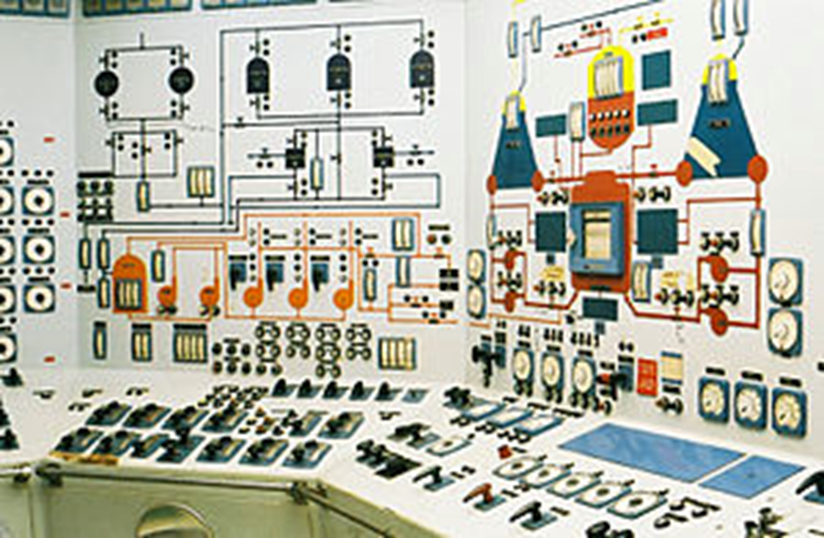
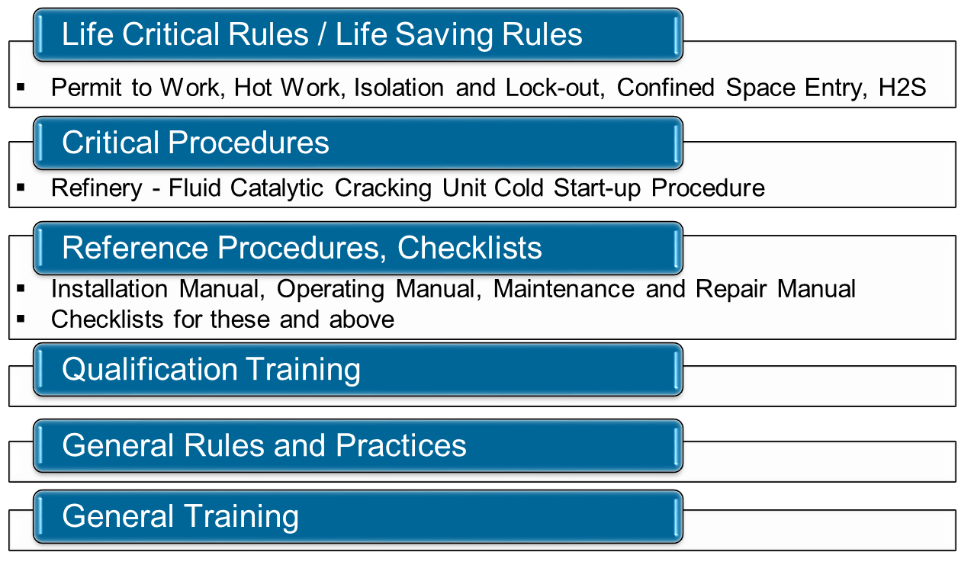
Summary and Key Lessons:
The RM Work Process and the RM System Elements are integrated, with purpose to assess and reduce risk, and
to manage and control residual risks for different activities.
Chapter 3.1-3.2-3.3: RM Program, Work Process, System & Elements
25
Notes:
25

Slide 26
Any questions?
Notes:
26

